Slide 1
Mobile Price Classification
Machine Learning Mini Project
Under The Guidance: Prof. Arundhati Das
Name: R B Ch S Tarun

Slide 2
Contents
Introduction
Glimpse Of Dataset
Algorithm’s Used
Importing Libraries And Dataset
Analyzing The Data
Modelling
Accuracy Measures
Conclusion
Applying Algorithm To Test Data
References

Slide 3
Introduction
We are going to do implementing a salable model for predicting the mobile price prediction using some of the regression techniques based of some of features in the dataset which is called mobile Price Prediction.
There are some of the processing techniques for creating a model.
Factors Considered: battery capacity, color, clock speed, dual sim, network type, storage capacity, weight, height, weight, ram,
This kind of prediction will help companies estimate price of mobiles to give tough competion to other mobile manufacturer

Slide 4
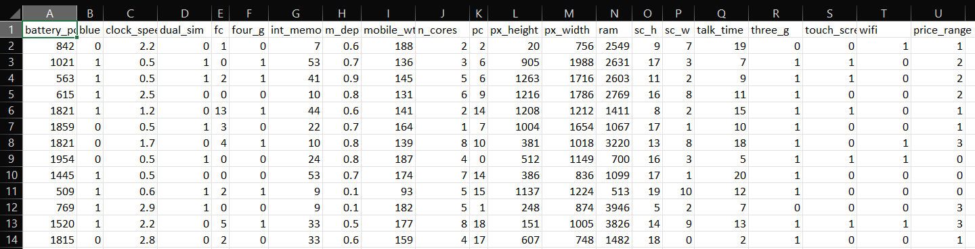
Glimpse Of Dataset

Slide 5
Algorithm’s Used
The major aim of in this project is to predict the house prices based on the features using some of the regression techniques and algorithms.
Logistic Regression
Support Vector Classification(SVM)
Naive Bayes
ID3 Decision Tree Classifier

Slide 6
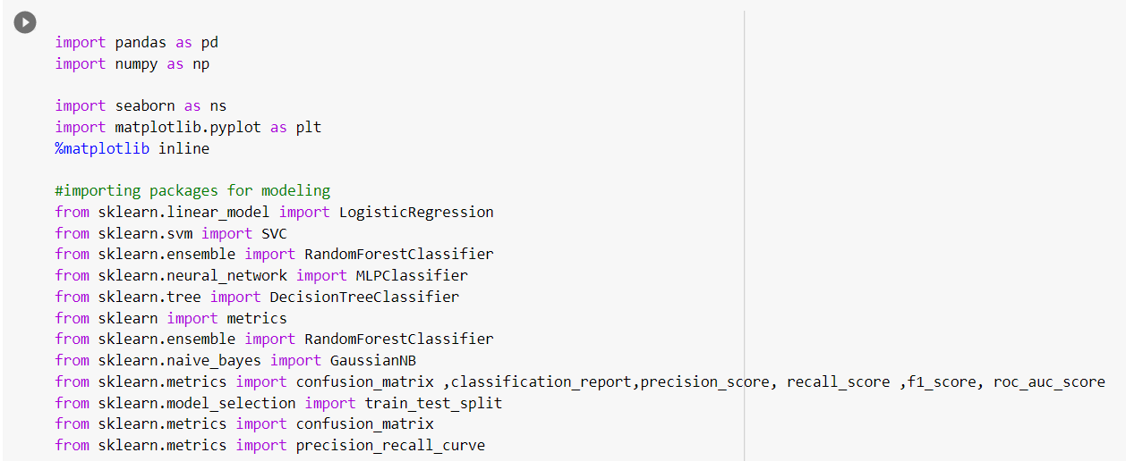
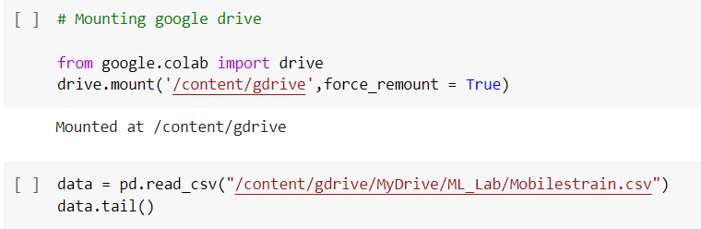
Importing Libraries And Dataset

Slide 7
Analyzing the Data
data.info()
data.isnull().sum()
data = data.drop("talk_time",axis =1)
sns.countplot(x="price_range", data=data)
sns.jointplot(x='ram',y='price_range’,
data=data,color='green',kind='kde');
Used to get the overall information about the data
Checks the sum of null values in dataframe
Dropped unnecessary data
Plots the variation of price range with respect to features
Plots the graph on how the Increase in
RAM effecting the price

Slide 8
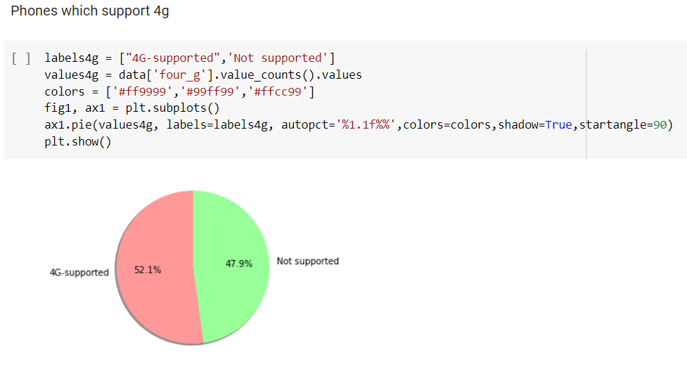
Analyzing the Data

Slide 9
Modelling
Logistic Regression - from sklearn.linear_model import LogisticRegression
Support Vector Classification(SVM) - from sklearn.svm import SVC
Naive Bayes - from sklearn.naive_bayes import GaussianNB
ID3 Decision Tree Classifier - from sklearn.tree import DecisionTreeClassifier

Slide 10
Accuracy Measures
Model | Accuracy | Precision | Recall | AUC Curve
Logistic Regression | 0.78 | 0.782 | 0.782 | 0.93
Support Vector Classification | 0.86 | 0.864 | 0.864 | 0.96
Naïve Bayes | 0.82 | 0.818 | 0.818 | 0.94
Decision Tree | 0.83 | 0.834 | 0.834 | 0.95

Slide 11
Conclusion
As we can see from the Accuracy measures, the model trained with Support Vector Machine(SVM) has better accuracy and performance scores compared to other so now lets put this model to get predections on Prices of Mobiles.

Slide 12
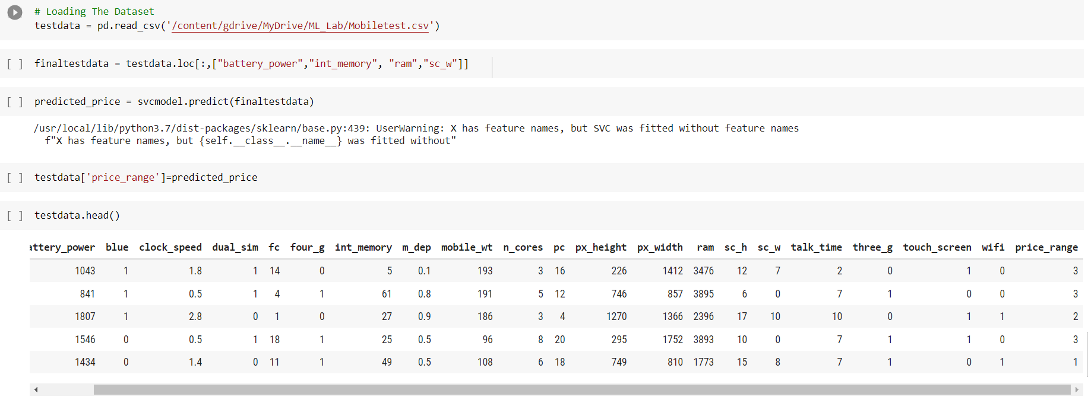
Applying Algorithm To Test Data

Slide 13
References
Dataset from: https://www.kaggle.com/iabhishekofficial/mobile-price-classification
https://scikit-learn.org/stable/modules/generated/sklearn.linear_model.LogisticRegression.html
https://scikit-learn.org/stable/modules/naive_bayes.html
https://www.analyticsvidhya.com/blog/2017/09/naive-bayes-explained/
https://www.analyticsvidhya.com/blog/2017/09/understaing-support-vector-machine-example-code/

